Slide 1
Microservices Principles, Patterns and Implementation considerations
WW Developer Advocate Team

Slide 2
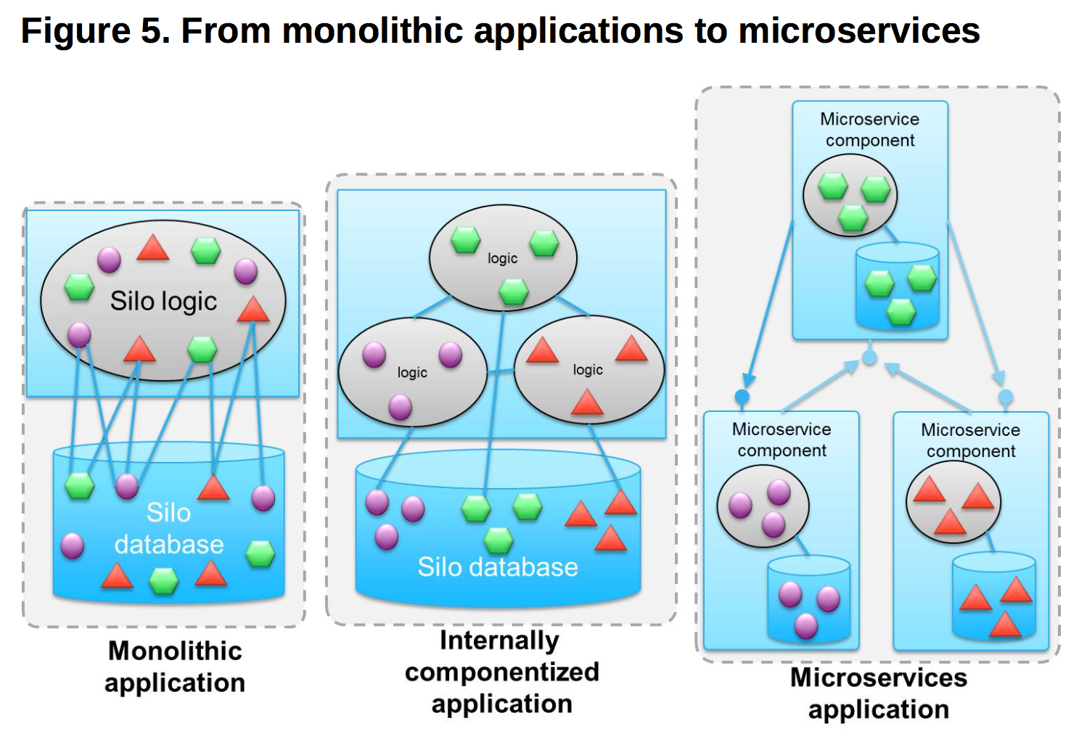
Microservices and its Impact on CIO’s Agenda
“…the microservice architectural style.. ..is an approach to developing a single application as a suite of small services, each running in its own process and communicating with lightweight mechanisms, often an HTTP resource API. …”
Martin Fowler
http://martinfowler.com/articles/microservices.html
Agility and productivity
The team that is developing the microservice can completely understand the codebase
They can build, deploy, and test it independently of other components in much faster iteration cycles
Scalability
The Microservices development team can scale the component at run time independently of other microservice components
These Microservices take advantage of the elastic capabilities of cloud-native environments that have cost-effective access to enormous resources
Resilience
The separate run time immediately provides resilience that is independent of failures in other components
Technologies such as containers enable microservice components to fail quickly and independently, instead of taking down whole areas of unrelated functionality

Slide 3
Microservices – Fundamentals
Microservices Architecture
Encapsulation is key
Microservice as API enabler
Simplistically, microservices architecture is about breaking down large silo applications into more manageable fully decoupled pieces
SOA done well
Related logic and data should remain together, and which means drawing strong boundaries between Microservices.
Business Centric
The “service” in “microservice” refers to the granularity of the components, not the exposed interfaces
Microservice
(component)
Silo logic
Silo
Microservice
(component)
Agility
Scalability
Resilience
Microservice
(component)
Silo
data
Monolithic
application
Microservices
application
An application split into Microservices may well expose the same APIs as its monolithic equivalent
A microservice is a granular decoupled component within a broader application

Slide 4
Key takeaways
Business Oriented
Microservices need to focus on a unit of work, and as such they are small. There are no rules on how small a microservice must be but making them too small can cause latency.
A microservice needs to be treated like an application or a product. It should have its own source code management repository, and its own delivery pipeline for builds and deployment.
Microservices powered applications provide light weight communication mechanism through the use of technology agnostic APIs.
Microservices should have independent storage, should be independently changeable, should be independently deployable, should support distributed transactions.
Reuse isn’t the only business motivation for microservices. There are others, such as localized optimizations to improve user interface (UI) responsiveness and to be able to respond to customer needs more rapidly.

Slide 5
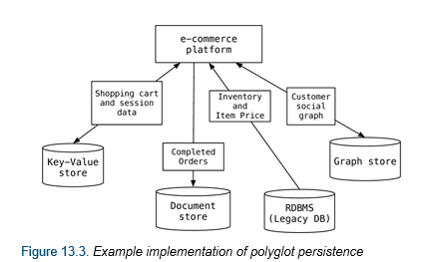
Polyglot Persistence
Ideally, you want every microservice to manage its own database. This enables polyglot persistence, using different databases (for example, Cloudant versus MongoDB, both of which are NoSQL) and different types of data stores (such as Structured Query Language (SQL), NoSQL, graph).
However, we might need to have more than one microservice use the same database for one of many reasons, for example, to preserve the ACID nature of a transaction that would otherwise be distributed across microservices and databases.
Database Type | Examples | When best used
Key-Value Databases | Compose for Redis, Memcached, Amazon DynamoDB | Storing interaction data, user preferences, simple shopping carts. Not great at set operations.
Document Databases | Cloudant, Compose for MongoDB | Event logging, content management, analytics. Not great at complex queries.
Column-Family Databases | Cassandra, Db2 BLU components for DB2 as a Service | Event logging, counters, blogs. Not compatible with ACID txns.
Graph Databases | Compose for Janus, Neo4J, OrientDB | Social Networks, Location-based Services. Not optimal for certain types of bulk updates.

Slide 6
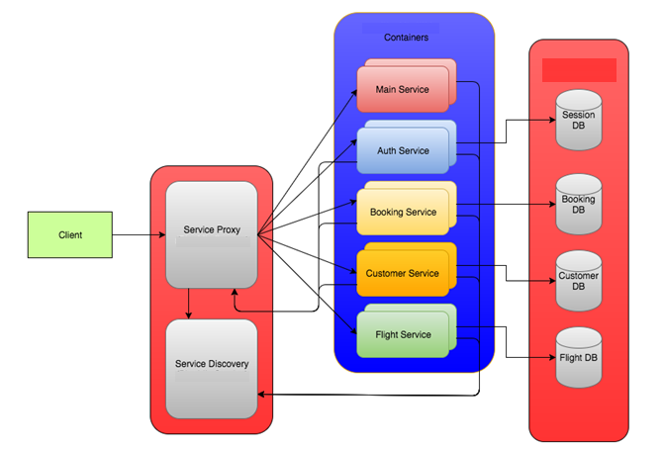
Microservice Solution Overview
Here is a hypothetical Airline solution broken up into the following standalone services.
Main app - presentation layer
Auth Service - manages sessions (login, logout, validation)
Customer Service - manages customer Info (get, update, validate password)
Flight Service - manages flight data
Booking Service - manages booking data
Support Service - a simple dummy websocket chatroom (may add a cognitive service here)
Multiple instances of each service can be created.
A service proxy is setup in front of the services to route/load balance them.
​The Auth, Booking, and Customer services also need to know how to reach the proxy because they call other services.
Service Discovery manages the micro-services.
The DBs can be separate instances (recommended) or one big instance.

Slide 7
Microservices Design principles
High Cohesion
Loose Coupling
Business centric
Resilience
Observable
Automated

Slide 8
High Cohesion
Each microservices should have a single function or focus. example domain centric.
Revisit our flight data example:
Booking Service – The booking service allows you to browse flights (flight service), book tickets, payment service, generate invoice, send emails etc.
In its simplest form, It could be implemented as seen in the first diagram where the booking UI and service are tightly coupled and hence “less” cohesive.
Using the principles of high cohesion, we can further divide this functionality into multiple smaller, independent and focused micro services.
High cohesion would allow us to manage each of these functionalities better, example if we change payment logic or email templates then it would not change the booking service and invoice service.

Slide 9
Loose Coupling
Each microservice should be loosely coupled with other microservices
Decouple microservices over the network:
Synchronous Communication
Asynchronous Communication
Use Open communication protocols
HTTP/REST is standard being technology agonistic
Avoid Client libraries resulting in RMI/EJB kind of communication
Standard interface for communication
Have agreed interface for microservice communication
Decouple internal representation of data within a microservice from how data is exchanged between two services.
Develop versioning strategy
New changes should not break existing contract
Should be backward compatible
If breaking changes are unavoidable, then have parallel versions in play.
Use semantic versioning to relay compatibility – Major, Minor, Patch
Provide a migration strategy to consumers when new versions (not backward compatible) are available.

Slide 10
Business Domain Centric
Each microservices should map to a business domain or business function
Microservices can be defined iteratively on the basis of business domain or business functions. These domains can initially be defined in a coarse manner and then further split into possible business functions.
Remember high cohesion and loose coupling principles when splitting microservices. This also helps us align and group services better with the right teams within a large organization.
Business services can delegate to other business services. Avoid circular dependencies. Careful that each service still implements a complete task. Not separate layers
Business Service 1
Business Service 2
Business Service 3
Business Service 4
Business Service 5
Business Service 6
Business Service 7

Slide 11
Resilience
Build microservices for resiliency
Design for failures for down stream service.
When happens on failures
Degrade functionality
Default functionality
Design for fail fast
Consider the usage/configuration of retries and timeouts. A long hanging transaction will not lead to a good user experience.
Retries and Timeouts also help with network failures along with service failures

Slide 12
Observable – Monitoring and Logging
Centralized Monitoring
Use Real time monitoring
Monitor for operational indicator
CPU, memory etc
Have services expose metrics which can be centrally logged and monitored
Response times, Exceptions, Time-outs, Retries
Aggregate monitoring data
Use tools to help allow data aggregation, visualization to help see patterns and alert triggers.
Centralized Logging
Critical in context of Microservices with multiple microservices having multiple instances.
Critical to understand the lifecycle of how a request was processed in a distributed manner.
Include data such as host name, correlation id to help enable tracing a transaction across multiple services.
The log format should be consistent to help allow manage and query these logs later.

Slide 13
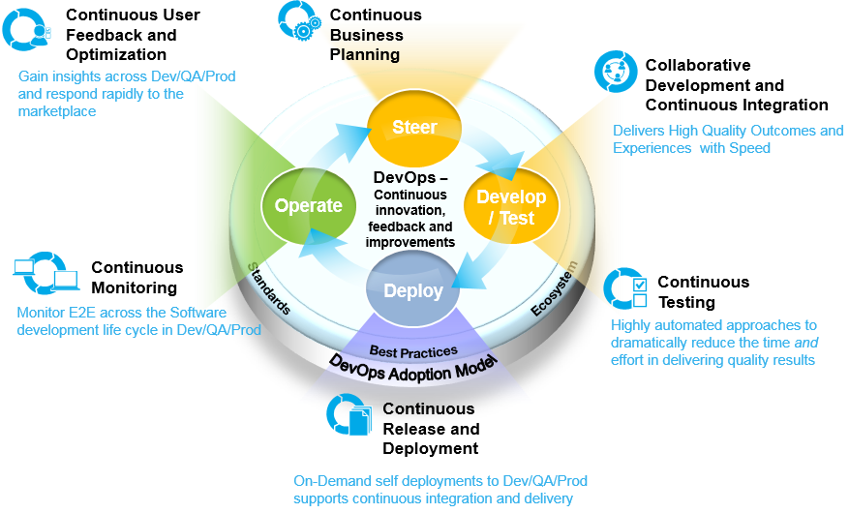
Automation
Devops principles for developing microservices

Slide 14
Automated
Use the DevOps practices from the IBM Cloud Innovate Method
Continuous Business Planning
Continuous User Feedback and Optimization
Continuous Monitoring
Collaborative Development and Continuous Integration
Continuous Release and Deployment
Continuous Testing
Notes:
Should we use the IBM Cloud “method” loop here instead???!!!!

Slide 15
Microservices Implementation Considerations
Communication
Hosting
Registration & Discovery
Monitoring
Logging
Caching
Scaling
APIs
Automation

Slide 16
Communication patterns
Synchronous Communication
HTTP/REST – Technology agnostic
Have to wait until a response is received
Design for failures – use timeouts or retries
Asynchronous Communication
Event based communication – instead of connecting directly to service, the service will publish an event which can be consumed by another service to be able to process the request.
No need to wait for the response
Use technologies such as Message Queuing

Slide 17
Hosting considerations
Virtualization
Containerization
Self Hosting
A common practice is to run one microservice per container.

Slide 18
Registration and Discovery
Service Registry Database
What to register?
Host, port, version
When to register
On Startup
When to deregister
On failures
Cloud platforms makes it easy to manage registration and discovery. This has to be self managed mostly in a self hosted scenario.
Service lookup patterns
Client connects to service registry – Client side discovery
Client connects to Gateway/Load Balancer to further connect to service registry – Server side discovery

Slide 19
Monitoring and Logging Technology
Centralized Monitoring tools
Example Nagios or New Relic
Collect Metrics
Aggregate
Visualize data
Send test transactions and monitor test transactions
Monitor network
Send alerts when required
Centralized Logging
Example Logstash, Elastic log, splunk
The logs needs to be pushed to these tools which can then be stored in a database. Capabilities provided are:
Push logs
Query log
Aggregate log from multiple servers
Provide logging libraries for client side
Visualize data
Supports standardized logging

Slide 20
Performance Considerations
Scaling
Horizontal Scaling is preferred and readily supported through cloud capabilities.
Scaling can be automated or made on-demand
Automated
API Gateway
Load balancing and Caching
Centralized Security
Centralized Analytics
Centralized service discovery
Centralized entry points
Caching
Helps improve performance
Ideally implemented at API gateway layer
Can also be done on client layer example for SPA applications
Can also be done at service layer example for static data

Slide 21
References
https://martinfowler.com/articles/microservices.html
http://www.redbooks.ibm.com/abstracts/sg248275.html?Open
https://www.nginx.com/blog/microservices-at-netflix-architectural-best-practices/
https://w3-03.sso.ibm.com/services/lighthouse/documents/D023183V03153V20
https://12factor.net/
http://www.grahamlea.com/2016/08/distributed-transactions-microservices-icebergs/
http://microservices.io/patterns/index.html

Slide 22
Lab: Stock Trader Lite sample for IBM Cloud Kubernetes Service
IBM Cloud Kubernetes Service
IBM Cloud
MariaDB
Browser
Buy 100 AAL
Tradr
(Node)
Portfolio (Spring)
Stock
Quote (Node)
API
Connect
IEX
Cloud API
Confirmation
Summary
Watson
Tone Analyzer
Trade
History (Microprofile)
Event consumer (Spring)
Kafka
DNS Proxy
Kafka
(IBM Event Streams)
Mongo
Notes:
This is an animated slide completed in 4 clicks to show how Stock Trader lite works:
After the first click: Shows a “Buy” request from the Web App Tradr calling the Portfolio service. It sends a request to the StockQuote service to get the latest price of the stock being purchased via an API Connect Proxy to an external stock quote service. The trade is recorded in MariaDB and a conf is sent back to the UI
After 2nd click : The Portfolio svc sends the details of the transaction to a Kafka topic via a Kafka prpxy running in the K8s cluster.
After 3rd click: The Event Consumer svc reads the message published to Kafka and updates Mongo
After 4th click: The Web App also will request a portfolio summary (eg YTD loss/gain) from the Portfolio svc which calls the Trade History service to query the trade history in Mongo and return a summary to the Web App

Slide 23
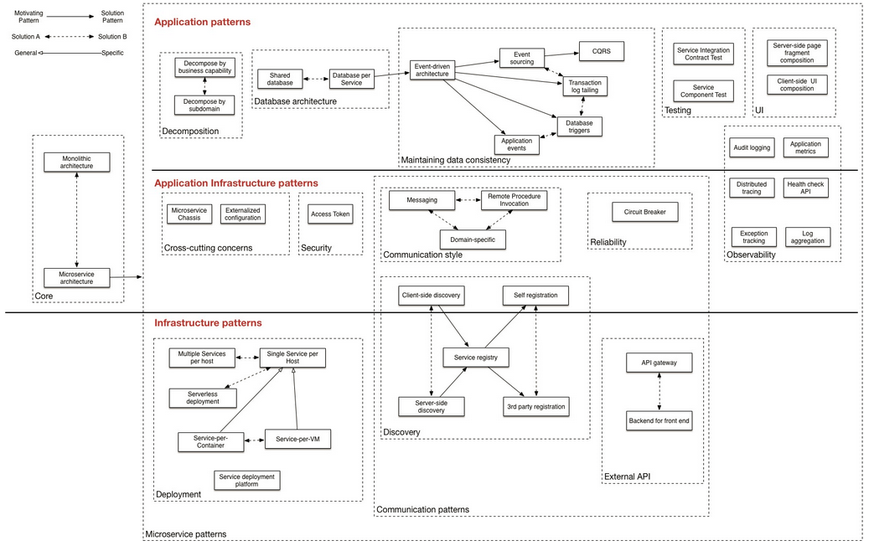
Microservices Patterns
Service discovery
Client-side discovery
Server-side discovery
Service registry
Self registration
3rd party registration
Data management
Database per Service
Shared database
Event-driven architecture
Event sourcing
Transaction log tailing
Database triggers
Application events
CQRS
Observability
Log aggregation
Application metrics
Audit logging
Distributed tracing
Exception tracking
Health check API
UI patterns
Server-side page fragment composition
Client-side UI composition
Testing
Service Component Test
Service Integration Contract Test
Reliability
Circuit Breaker
Microservices.io defines these patterns well - http://microservices.io/patterns/index.html
Core patterns
Monolithic architecture
Microservice architecture
Decomposition
Decompose by business capability
Decompose by subdomain
Deployment patterns
Multiple service instances per host
Service instance per host
Service instance per VM
Service instance per Container
Serverless deployment
Service deployment platform
Cross cutting concerns
Microservice chassis
Externalized configuration
Communication style
Remote Procedure Invocation
Messaging
Domain-specific protocol
External API
API gateway
Backend for front-end
Security
Access Token

